Slide 1
Introduction to the Internet and Web

Slide 2
Internet
It is the largest network in the world that connects hundreds of thousands of individual networks all over the world.
The popular term for the Internet is the “information highway”.
Rather than moving through geographical space, it moves your ideas and information through cyberspace – the space of electronic movement of ideas and information.

Slide 3
Internet
No one owns it
It has no formal management organization.
As it was originally developed by the Department of defense, this lack of centralization made it less vulnerable to wartime or terrorist attacks.
To access the Internet, an existing network need to pay a small registration fee and agree to certain standards based on the TCP/IP (Transmission Control Protocol/Internet Protocol) .

Slide 4
The uses of the Internet
Send e-mail messages.
Send (upload) or receive (down load) files between computers.
Participate in discussion groups, such as mailing lists and newsgroups.
Surfing the web.

Slide 5

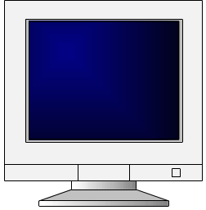
Web Essentials
Client: web browsers, used to surf the Web
Server systems: used to supply information to these browsers
Computer networks: used to support the browser-server communication
Request “document A”
document A
Client
Server

Slide 6
Internet vs. WWW
Most people use the two terms interchangeably but they are in fact different.
The Internet is a vast, international network, made up of computers and the physical connections (wires, routers, etc.) allowing them to communicate.
The World Wide Web (WWW or just the Web) is a collection of software that spans the Internet and enables the interlinking of documents and resources.
  Provides a way of accessing information on the Internet.

Slide 7
Internet v.s. Web
The Internet: a inter-connected computer networks, linked by wires, cables, wireless connections, etc.
Web: a collection of interconnected documents and other resources.
The world wide web (WWW) is accessible via the Internet, as are many other services including email, file sharing, etc.

Slide 8
Web Servers and Clients
A Web server is a computer that is programmed to send files to browsers on other computers connected to the Internet.
The Web browser, such as Firefox or Internet Explorer, is the client that sends a request for a Web page.
The Web server answers the request and delivers the requested page to the browser so you can view it.

Slide 9
The World Wide Web (WWW)
WWW is a system of interlinked, hypertext documents that runs over the Internet
Two types of software:
  Client: a system that wishes to access the information provided by servers must run client software (e.g., web browser)
  Server: an internet-connected computer that wishes to provide information to others must run server software
  Client and server applications communicate over the Internet by following a protocol built on top of TCP/IP – HyperText Transport Protocol (HTTP)

Slide 10
Basics of the WWW
Hypertext: a format of information which allows one to move from one part of a document to another or from one document to another through hyperlinks
Uniform Resource Locator (URL): unique identifiers used to locate a particular resource on the network
Markup language: defines the structure and content of hypertext documents

Slide 11
Web Client: Browser
Makes HTTP requests on behalf of the user
  Reformat the URL entered as a valid HTTP request
  Use DNS to convert server’s host name to appropriate IP address
  Establish a TCP connection using the IP address
  Send HTTP request over the connection and wait for server’s response
  Display the document contained in the response
    If the document is not a plain-text document but instead is written in HTML, this involves rendering the document (positioning text, graphics, creating table borders, using appropriate fonts, etc.)

Slide 12
What is Web?
The Web (World Wide Web) consists of information organized into Web pages containing text and graphic images.
It contains hypertext links, or highlighted keywords and images that lead to related information.
A collection of linked Web pages that has a common theme or focus is called a Web site.
The main page that all of the pages on a particular Web site are organized around and link back to is called the site’s home page.

Slide 13
How to access the Internet?
Many schools and businesses have direct access to the Internet using special high-speed communication lines and equipment.
Students and employees can access through the organization’s local area networks (LAN) or through their own personal computers.
Another way to access the Internet is through Internet Service Provider (ISP).

Slide 14
How to access the Internet?
To access the Internet, an existing network need to pay a small registration fee and agree to certain standards based on the TCP/IP (Transmission Control Protocol/Internet Protocol) reference model.
Each organization pays for its own networks and its own telephone bills, but those costs usually exist independent of the internet.
The regional Internet companies route and forward all traffic, and the cost is still only that of a local telephone call.

Slide 15
Internet Service Provider (ISP)
A commercial organization with permanent connection to the Internet that sells temporary connections to subscribers.
Examples:
  BSNL, Vodafone, Idea, Airtel, etc..

Slide 16
How to access the Web?
Once you have your Internet connection, then you need special software called a browser to access the Web.
Web browsers are used to connect you to remote computers, open and transfer files, display text and images.
Web browsers are specialized programs.
Examples of Web browser: Netscape Navigator (Navigator) and Internet Explorer.

Slide 17
Client/Server Structure of the Web
Web is a collection of files that reside on computers, called Web servers, that are located all over the world and are connected to each other through the Internet.
When you use your Internet connection to become part of the Web, your computer becomes a Web client in a worldwide client/server network.
A Web browser is the software that you run on your computer to make it work as a web client.

Slide 18
Hypertext Markup Language (HTML)
The public files on the web servers are ordinary text files, much like the files used by word-processing software.
To allow Web browser software to read them, the text must be formatted according to a generally accepted standard.
The standard used on the web is Hypertext markup language (HTML).

Slide 19
Hypertext Markup Language (HTML)
HTML uses codes, or tags, to tell the Web browser software how to display the text contained in the document.
For example, a Web browser reading the following line of text:
<B> A Review of the Book
<I>Wind Instruments of the 18th Century
</I>
</B>
recognizes the <B> and </B> tags as instructions to display the entire line of text in bold;
<I> and </I> tags as instructions to display the text enclosed by those tags in italics.

Slide 20
Addresses on the Web:IP Addressing
Each computer on the internet does have a unique identification number, called an IP (Internet Protocol) address.
The IP addressing system currently in use on the Internet uses a four-part number.
Each part of the address is a number ranging from 0 to 255, and each part is separated from the previous part by period,
For example, 106.29.242.17

Slide 21
IP Addressing
The combination of the four IP address parts provides 4.2 billion possible addresses (256 x 256 x 256 x 256).
This number seemed adequate until 1998.
Members of various Internet task forces are working to develop an alternate addressing system that will accommodate the projected growth.
However, all of their working solutions require extensive hardware and software changes throughout the Internet.

Slide 22
Domain Name Addressing
Most web browsers do not use the IP address t locate Web sites and individual pages.
They use domain name addressing.
A domain name is a unique name associated with a specific IP address by a program that runs on an Internet host computer.
This program, which coordinates the IP addresses and domain names for all computers attached to it, is called DNS (Domain Name System ) software.
The host computer that runs this software is called a domain name server.

Slide 23
Domain Name Addressing
Domain names can include any number of parts separated by periods, however most domain names currently in use have only three or four parts.
Domain names follow hierarchical model that you can follow from top to bottom if you read the name from the right to the left.
For example, the domain name gsb.uchicago.edu is the computer connected to the Internet at the Graduate School of Business (gsb), which is an academic unit of the University of Chicago (uchicago), which is an educational institution (edu).
No other computer on the Internet has the same domain name.

Slide 24
Uniform Resource Locators
The IP address and the domain name each identify a particular computer on the Internet.
However, they do not indicate where a Web page’s HTML document resides on that computer.
To identify a Web pages exact location, Web browsers rely on Uniform Resource Locator (URL).
URL is a four-part addressing scheme that tells the Web browser:
  What transfer protocol to use for transporting the file
  The domain name of the computer on which the file resides
  The pathname of the folder or directory on the computer on which the file resides
  The name of the file

Slide 25
Structure of a Uniform Resource Locators
pathname
protocol
http://www.chicagosymphony.org/civicconcerts/index.htm
Domain name
filename
http => Hypertext Transfer Protocol

Slide 26
HTTP
Stands for HyperText Transfer Protocol
Allows computers on the WWW to communicate with one another.
Handles the “request” sent to the Web server and the “response” received from the Web server.

Slide 27
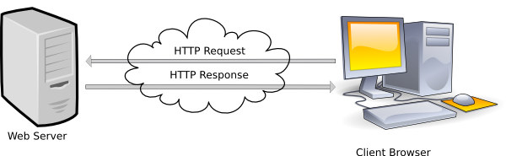
Web Server-Client Diagram

Slide 28
URLs
Stands for Uniform Resource Locator
Also called the Web page’s address
You typically type it into your Web browser’s location bar when you want to view a Web page
http://www.umbc.edu
Protocol needed to communicate with Web server
Name of Web server

Slide 29
HTML
Stands for HyperText Markup Language
Used to create a Web page
Made up of tags that specify the structure of the document (this section is a heading, this section is a paragraph, etc..)
An excerpt from a sample HTML document:
<html>
<head>
<title>Bob’s Web page</title>
</head>
<body>
<h1>This is my first Web page</h1>

Slide 30
HTML Tags
Most HTML tags work in pairs. There is an opening and a closing tag. For example:
<p>Some content here.</p>
The <p>…</p> tag displays a paragraph
<p> opens the paragraph (opening tag)
</p> closes the paragraph (closing tag)
“Some content here.” will be displayed on the page

Slide 31
Self-closing Tags
Some HTML tags are self closing. For example:
<br />
The <br /> tag will display a line break.

Slide 32
HTTP
The transfer protocol is the set of rules that the computers use to move files from one computer to another on the Internet.
The most common transfer protocol used on the Internet is the Hypertext Transfer Protocol (HTTP).
Two other protocols that you can use on the Internet are the File Transfer Protocol (FTP) and the Telnet Protocol

Slide 33
How to find information on the Web?
A number of search tools have been developed and available to you on certain Web sites that provide search services to help you find information.
Examples:
Yahoo → www.yahoo.com
Excite → www.excite.com
Lycos → www.lycos.com
AltaVista → www/alta-vista.com
MSN WebSearch → www.search.msn.com

Slide 34
How to find information on the Web?
You can find information by two basic means.
Search by Topic and Search by keywords.
Some search services offer both methods, others only one.
Yahoo offers both.
  Search by Topic
    You can navigate through topic lists
  Search by keywords
    You can navigate by entering a keyword or phase into a search text box.

Slide 35
The Evolution of the Internet
Internet
  Interconnected network of computer networks
  ARPAnet
    Advanced Research Project Agency
    1969 – four computers connected
  NSFnet
    National Science Foundation
  Use of the Internet was originally limited to government, research and academic use
  1991 Commercial ban lifted

Slide 36
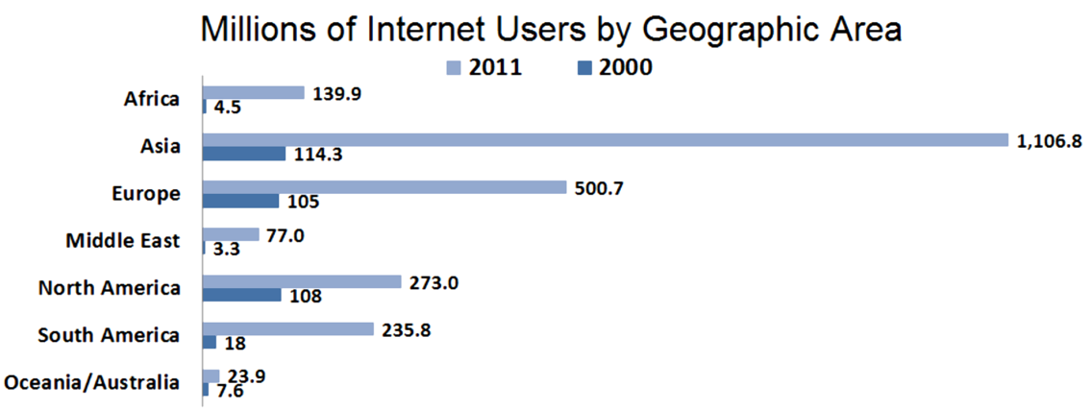
Growth of the Internet
Figure 1.1 Growth of Internet Usage
Statistics from www.internetworldstats.com. Copyright © 2001 - 2012, Miniwatts Marketing Group. All rights reserved worldwide.

Slide 37
Reasons for
Internet Growth in the 1990s
Removal of the ban on commercial activity
Development of the World Wide Web by Tim Berners-Lee at CERN
Development of Mosaic, the first graphics-based web browser at NCSA
Convergence of technologies:
  Affordable personal computers with GUI Operating Systems
  Affordable Internet service providers

Slide 38

The World Wide Web
The graphical user interface to information stored on some of the computers connected to the Internet.

Slide 39

Web Standards and the W3C Consortium
W3C – World Wide Web Consortium
  Develops recommendations and prototype technologies related to the Web
  Produces specifications, called Recommendations, in an effort to standardize web technologies
  WAI – Web Accessibility Initiative

Slide 40
Web Accessibility
“The power of the Web is in its universality. Access by everyone regardless of disability is an essential aspect.” – Tim Berners-Lee
Accessible Websites
provide accommodations that help individuals to individuals with visual, auditory, physical, and neurological disabilities overcome barriers
WAI – Web Accessibility Initiative
  Develops accessibility recommendations
  WCAG 2.0
  Web Content Accessibility Guidelines
  http://www.w3.org/WAI/WCAG20/quickref/

Slide 41
Web Accessibility
Section 508 of the Rehabilitation Act
  Requires that government agencies must give individuals with disabilities access to information technology that is comparable to the access available to others

Slide 42
Universal Design
“The design of products and environments to be usable by all people, to the greatest extent possible, without the need for adaptation or specialized design.”
– The Center for Universal Design
http://www.design.ncsu.edu/cud/about_ud/about_ud.htm

Slide 43
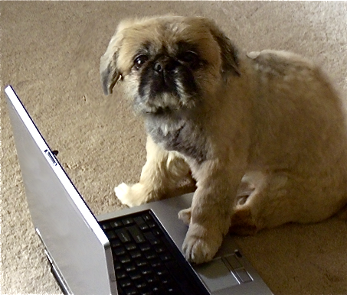
Information on the Web
Reliability and information
  Evaluate the credibility of the site
Ethical use of information
  Copyright and the Web

Slide 44
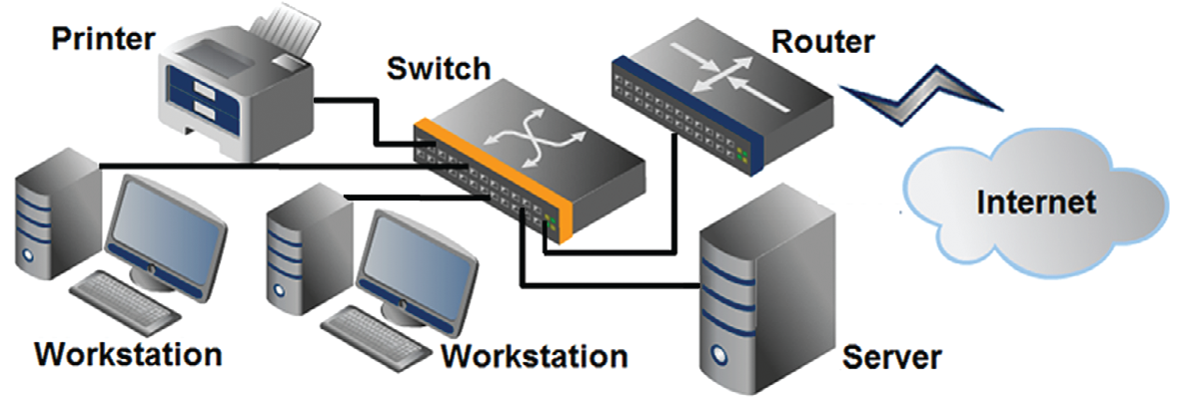
Network Overview
Network
two or more computers connected together for the purpose of communicating and sharing resources

Slide 45
The Client/Server Model
Client/Server can describe a relationship between two computer programs – the "client" and the "server".
Client
  requests some type of service (such as a file or database access) from the server.
Server
  fulfills the request and transmits the results to the client over a network

Slide 46
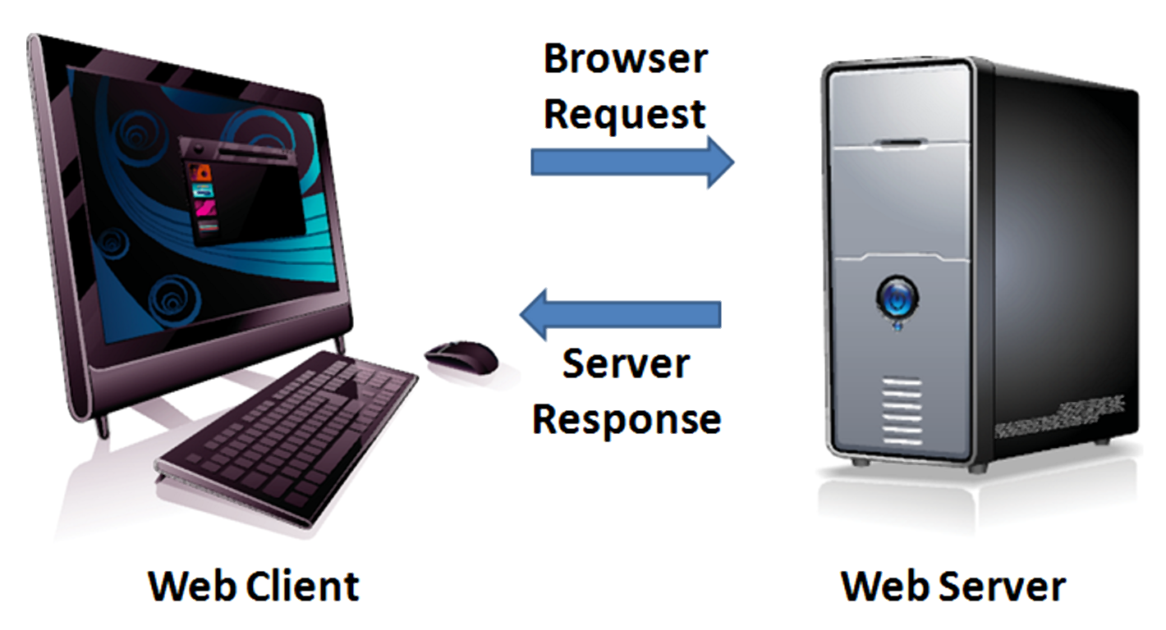
The Client/Server Model
The Internet
Client/Server Model
  Client: Web Browser
  Server: Web Server

Slide 47
Internet Protocols
Protocols
  Rules that describe the methods used for clients and servers to communicate with each other over a network.
There is no single protocol that makes the Internet and Web work.
A number of protocols with specific functions are needed.

Slide 48
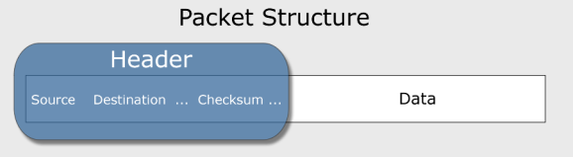
Common Internet Protocols
Official Communication Protocol: TCP/IP
Specialized Protocols:
  File Transfer: FTP
  E-mail: SMTP, POP3, IMAP
  Websites: HTTP

Slide 49
HTTP
Hypertext Transfer Protocol
A set of rules for exchanging files such as text, graphic images, sound, video, and other multimedia files on the Web.
Web browsers send HTTP requests for web pages and their associated files.
Web servers send HTTP responses back to the web browsers.
HTTP Request
HTTP Response

Slide 50
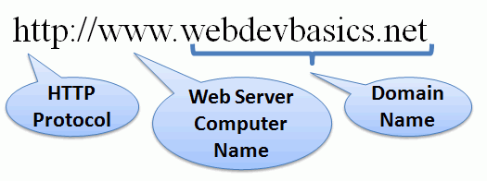
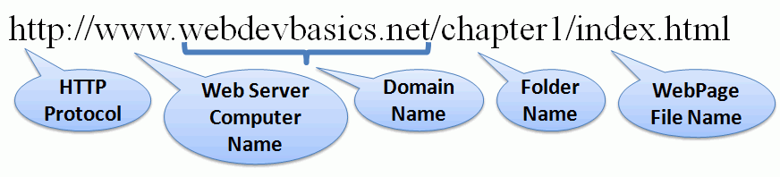
URI
Uniform Resource Indicator
URL
Uniform Resource Locator
Represents
the address
of a resource on the Internet.

Slide 51
TLD
Top-Level Domain Name
A top-level domain (TLD) identifies the right-most part of the domain name.
Some generic TLDs:
.com, .org, .net, .mil, .gov, .edu, .int, .aero, .asia, .cat, .jobs, .name, .biz, .museum, .info, .coop, .pro, .travel

Slide 52
County Code
TLDs
Two character codes originally intended to indicate the geographical location (country) of the web site.
In practice, it is fairly easy to obtain a domain name with a country code TLD that is not local to the registrant.
Examples:
  .tv, .ws, .au, .jp, .uk
  See http://www.iana.org/cctld/cctld-whois.htm

Slide 53



Domain Name System
The Domain Name System (DNS) associates
Domain Names with IP addresses.
Domain Name
DNS
IP Address
Web Browser requests web page
Web
Server
Use TPC/IP
to send HTTP Request
Use TCP/IP
to send HTTP Responses
with web page files & images
Web Browser
displays web page

Slide 54
Markup Languages
SGML – Standard Generalized Markup Language
  A standard for specifying a markup language or tag set
HTML – Hypertext Markup Language
  The set of markup symbols or codes placed in a file intended for display on a web browser.
    Element or tag – individual markup code
    Attribute – modifies the purpose of a tag

Slide 55
Markup Languages (2)
XML – eXtensible Markup Language
  A text-based language designed to describe, deliver, and exchange structured information.
  It is not intended to replace HTML –
  it is intended to extend the power of HTML by separating data from presentation.

Slide 56
Markup Languages (3)
XHTML – eXtensible Hypertext Markup Language
  Developed by the W3C as the reformulation of HTML 4.0 as an application of XML.
  It combines the formatting strengths of HTML 4.0 and the data structure and extensibility strengths of XML.

Slide 57

Markup Languages (4)
HTML 5
  The next version of HTML 4 and XHTML 1
    Currently in draft status
    Incorporates features of both HTML and XHTML
    Adds new elements
    Eliminates some elements
    Intended to be backward compatible
  http://www.w3.org/html/

Slide 58
Your First HTML5 Web Page: index.html
<!DOCTYPE html">
<html lang="en">
<head>
<title>Page Title Goes Here</title>
<meta charset="utf-8">
</head>
<body>
... body text and more HTML tags go here ...
</body>
</html>

Slide 59
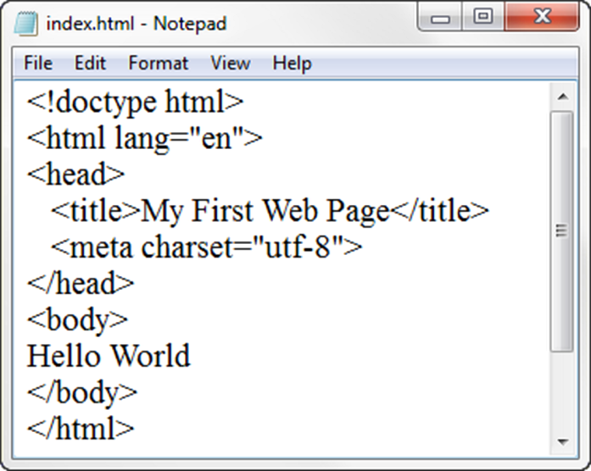
Under the Hood of a Web Page
DTD – describes the markup language syntax
HTML element– contains the web page document
Head element – contains the head section
The head section contains information that describes the
web page document
Title element– Text displays in title bar of window
Meta element – describes the character encoding
Body element – contains the body section
The body section contains the text and elements that
display in the browser viewport.

Slide 60
Static Web: HTML/XHTML, CSS
HTML stands for HyperText Markup Language
  It is a text file containing small markup tags that tell the Web browser how to display the page
XHTML stands for eXtensible HyperText Markup Language
  It is identical to HTML 4.01
  It is a stricter and cleaner version of HTML
CSS stands for Cascading Style Sheets
  It defines how to display HTML elements

Slide 61
Why Programmability?
What’s the drawback to simple document model?
  Static
  Assume that documents are created before they are requested
What are examples of information that might be part of web documents that may not be known before they are requested?

Slide 62
Client-Side Programmability
Scripting language: a lightweight programming language
Browser scripting: JavaScript
  Designed to add interactivity to HTML pages
  Usually embedded into HTML pages
  What can a JavaScript Do?
    Put dynamic text into an HTML page
    React to events
    Read and write HTML elements
    Validate data before it is submitted to a server
    Create cookies
    …

Slide 63
Server-Side Programmability
The requests cause the response to be generated
Server scripting:
  CGI/Perl: Common Gate Way Interface (*.pl, *.cgi)
  PHP: Open source, strong database support (*.php)
  ASP: Microsoft product, uses .Net framework (*.asp)
  Java via JavaServer Pages (*.jsp)
  …

Slide 64
What’s Ahead?
HTML, XHTML
CSS
Simple client-side interactivity (JavaScript)
Simple server-side interactivity (CGI/Perl) – Later Courses
We will not “teach” these languages
We will provide an overview of the basics, and learn how to use the web resources to help build a web page

Slide 65
Summary
This chapter provided a brief overview of Internet, Web, and introductory networking concepts along with your very first web page.

